Slide 1
MTN-016
Source Documentation, Resources, Additional Tips, and Reporting

Slide 2
Source Documentation
All staff should have a thorough understanding of the Source Documentation SOP
Use certified copies when appropriate to reduce duplication of effort and to ensure the MTN-016 participant binder can stand on its own.
Outside medical records
Parent protocol study documents

Slide 3
Source Documentation
Remember, chart notes can always be used to provide supplemental information:
Explain why procedures in addition to those listed on a checklist were performed
Explain why procedures listed on a checklist were not performed
Document procedures performed at interim visits
Justify updates to source documents, document discussions with participants, clarify something on a CRF, explain discrepancies, etc.

Slide 4
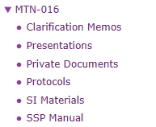
Resources
All resources discussed during this training are available on the MTN webpage under MTN-016:
www.mtnstopshiv.org

Slide 5
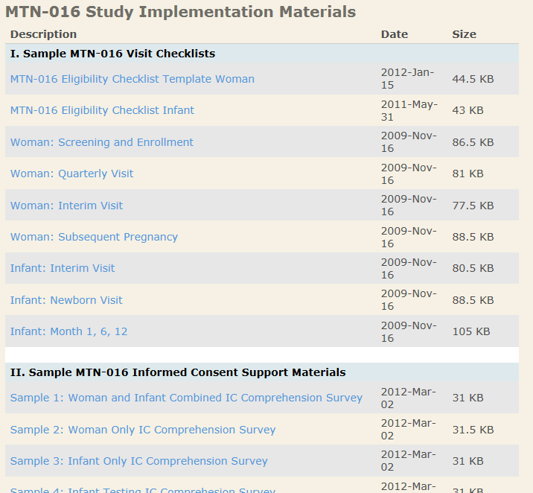
Resources
Study implementation tools section of website includes:
Template Visit Checklists
IC Comprehension Tools
Tools and Worksheets
Template SOPs
Operational Reminders
Because MTN-016 visits are so infrequent, it can be helpful to have resources for staff readily available. If there is a tool that would be helpful that you don’t have, ask the management team if they can develop it!

Slide 6
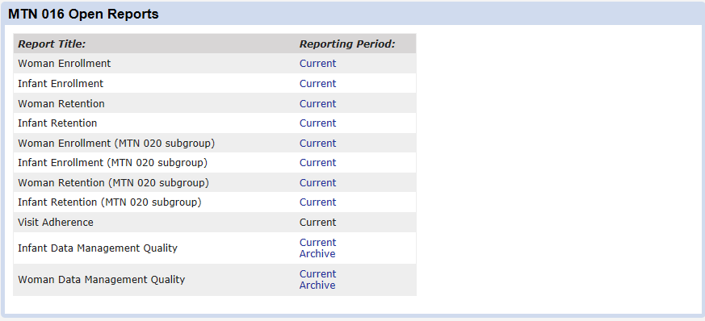
Reporting
SCHARP will post some reports to Atlas, based on information received via DataFax

Slide 7
Reporting
Additionally, each MTN-016 site is required to submit monthly accrual statistics directly to FHI 360 on the 15th of each month.
Notes:
Each site should update the appropriate row on the table and send to FHI 360 CRM each month. This report gets circulated to the protocol team by the end of the month.
Walk through these columns in a bit more detail, it seems to always confuse sites. For example, # parent study pregnancies includes any woman with a single positive pregnancy test (not 2 consecutive…that is part of 016 eligibility). # eligible for 016 are participants who meet all 016 eligibility criteria. Columns 3-5 should sum to equal column 2 (#eligible for 016), etc.

Slide 8
Questions?

